Slide 1
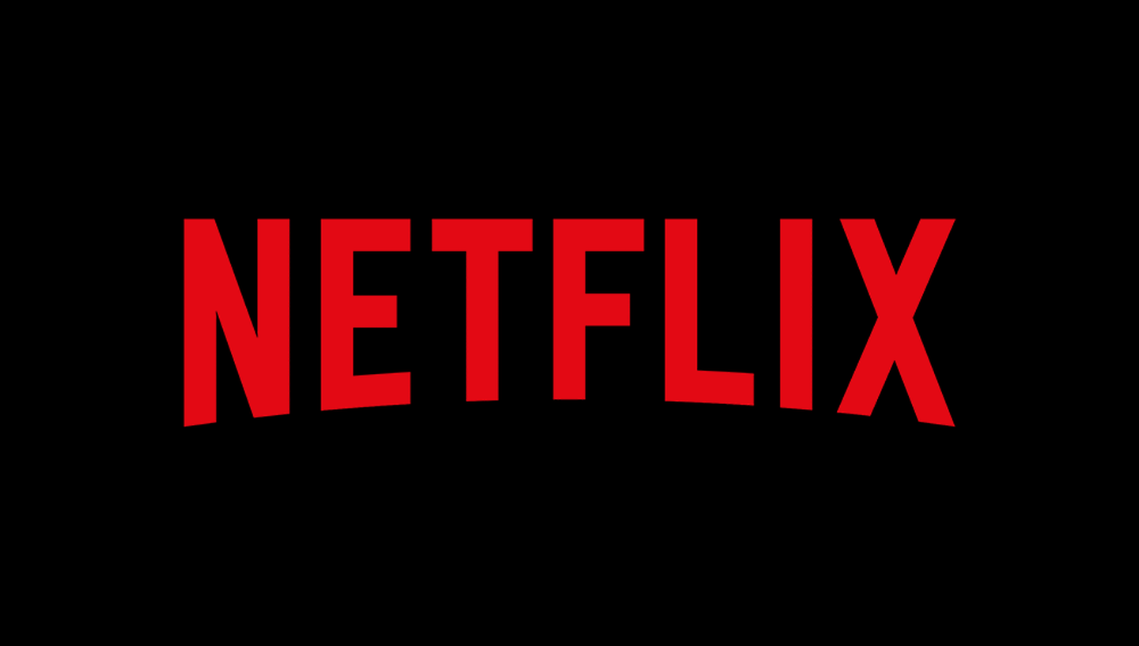
CUSTOMER DATA ANALYSIS
THE CUSTOMER STRIKES BACK
Customer Lifetime Value (CLV)
Nicolas GIBEY, Pooja BERA, Théophile VILLEMUR, Trong bao LUONG, Samuel SAINTON

Slide 2

NETFLIX CASE
In the near late 2011, Netflix wanted to boost its service price by using cross-selling strategy in its business. But after one month, the plan was canceled, which has led to losing nearly one million subscribers and half of its stock price. Keay considered the measurement of CLV as he believed new technologies would help customers receive more videos.
Before 2000, the customer only had few rental options and received the movies. Still, Netflix wants to develop a movie recommendation system to provide a much more efficient rental service, which has gained more revenue than a regular retail store ever offers.
After 2000, with the digital industry's development, more ways to approach the movie by the viewer and the company's algorithm have been improved to encourage the customer to rent more, leading to increased customer retention for Netflix.
All in all, the stock analyst wants to know how CLV could benefit from the change in operation and strategy.
1

Slide 3
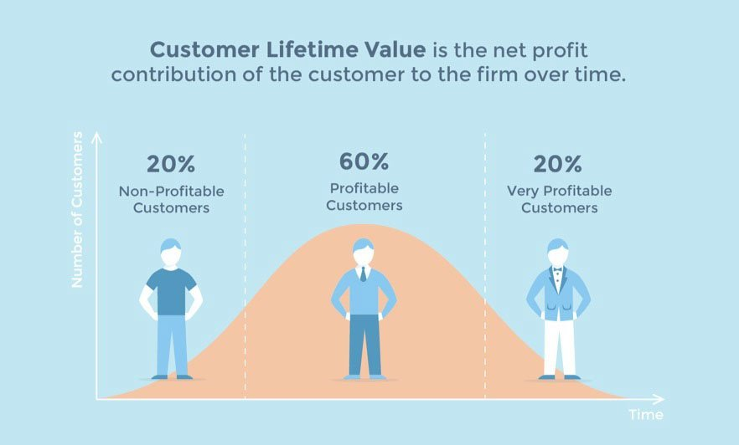
CUSTOMER LIFETIME VALUE
2

Slide 4
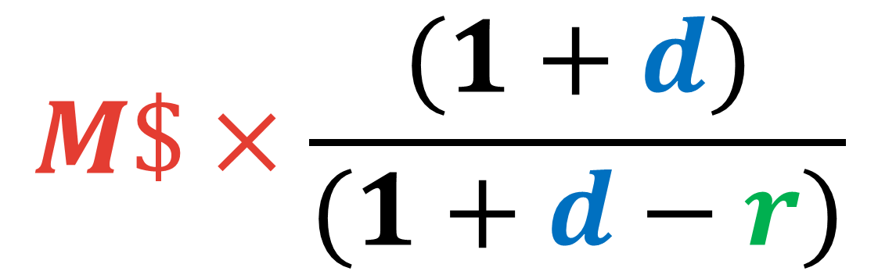
CUSTOMER LIFETIME VALUE FORMULA WITH INITIAL MARGIN
RETENTION RATE
$$M\$×\frac{(1+d)}{(1+d−r)}$$
MARGIN PER CUSTOMER
DISCOUNT RATE
3

Slide 5
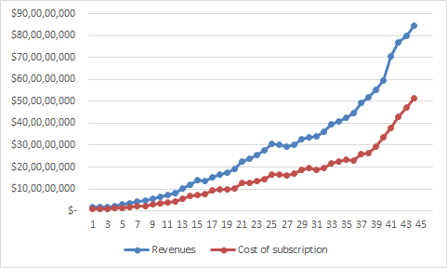
WHAT IS CONSTITUING REVENUE AND VARIABLE COST TO COMPUTE THE MARGIN (M)
Revenue is already given in the data table. It is the subscription fees paid by the customers. It is variable according to the number of customers.
The cost of revenue is already computed as the cost of subscription and the fulfillment expenses. It is variable according to the number of customers.
It is needed to add the technology and development expenses to have the full cost of revenues.
4

Slide 6

MARGIN
DISCOUNT RATE
RETENTION RATE
Result of : Total of revenues – Cost of revenues.
“Cost of subscription” and “fulfilment expenses” are already summed as “Cost of revenues” in the data table.
“Technology and development” is an operational cost related to the tech update of the business that must be added to the cost of revenues.
We will assume it is 10% during all the quarters.
Difference between the number of customer given a period divided by the number of customers the previous period.
Need to take into account the increase of customer between periods in order to have a net value.
5

Slide 7
COMPUTE RETENTION RATE
(IN DETAILS)
FROM THE CASE
Net pad subscribers : Total number of customers (or subscribers) per quarter MINUS the number of new subscribers (out of the total number of subscribers) per quarter.
Retention rate per quarter : the percentage of subscribers in the quarter who were also subscribers in the previous quarter.
6

Slide 8
VARIABLES FOR CUSTOMER LIFETIME VALUE WITH MARGIN
MARGIN
DISCOUNT RATE
10% FOR ALL QUARTERS
RETENTION RATE
(NB OF SUBSC. AT T1 – GROSS SUBSC. ADD.)/NB of SUBSC. AT T0
COST OF REVENUE – TECHNOLOGY & DEVELOPMENT EXPENSES
DATA TABLE
CASE STATEMENT
CASE & DATA TABLE
7
P.S. : No retention rate for the first quarter in the data table.

Slide 9
NETFLIX CUSTOMER LIFETIME VALUE WITH MARGIN
8

Slide 10
ARE NETFLIX’S CUSTOMERS METRICS A GOOD INDICATOR OF ITS MARKET VALUATION ?
Netflix's Customer metrics are not a good indicator of its market valuation because they are highly correlated to the profit margin.
CLV doens't allow us to get the company's true market valuation. The customer retention rate has also stayed stable between 70% & 80%.
Our CLV model has a constant discount rate of 10%, a retention rate, and a constant margin. The retention margin can fluctuate daily. In our case, the model takes the quarterly average as well as a constant discount rate of 10%.
9
Customer Lifetime Value was negative in 2001, went positive in 2002, but went down in 2011.

Slide 11
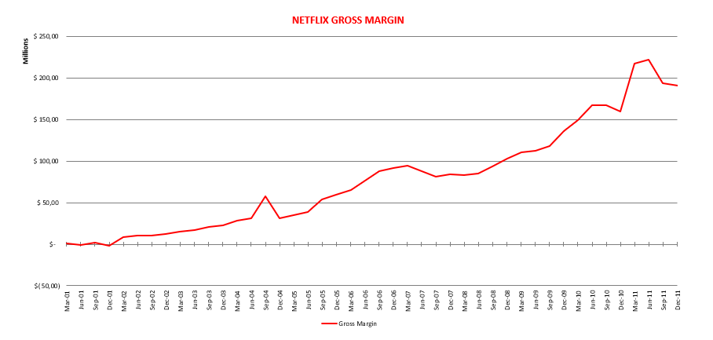
NETFLIX GROSS MARGIN
10

Slide 12
DO CLV METRICS MOVES WITH MORE STANDARDIZED VALUATION TECHNIQUES ?
$$CUSTOMER LIFETIME VALUE =\left(TURNOVER MADE BY A CUSTOMER OVER ONE YEAR −COST OF CUSTOMER OVER ONE YEAR\right)× AVERAGE DURATION OF THIS CUSTOMER RELATIONSHIP$$
𝑪𝑼𝑺𝑻𝑶𝑴𝑬𝑹 𝑳𝑰𝑭𝑬𝑻𝑰𝑴𝑬 𝑽𝑨𝑳𝑼𝑬 =(𝑇𝑈𝑅𝑁𝑂𝑉𝐸𝑅 𝑀𝐴𝐷𝐸 𝐵𝑌 𝐴 𝐶𝑈𝑆𝑇𝑂𝑀𝐸𝑅 𝑂𝑉𝐸𝑅 𝑂𝑁𝐸 𝑌𝐸𝐴𝑅 −𝐶𝑂𝑆𝑇 𝑂𝐹 𝐶𝑈𝑆𝑇𝑂𝑀𝐸𝑅 𝑂𝑉𝐸𝑅 𝑂𝑁𝐸 𝑌𝐸𝐴𝑅)× 𝐴𝑉𝐸𝑅𝐴𝐺𝐸 𝐷𝑈𝑅𝐴𝑇𝐼𝑂𝑁 𝑂𝐹 𝑇𝐻𝐼𝑆 𝐶𝑈𝑆𝑇𝑂𝑀𝐸𝑅 𝑅𝐸𝐿𝐴𝑇𝐼𝑂𝑁𝑆𝐻𝐼𝑃
Formula is interesting to use when, like Netflix, it is a service with a fixed and stable price → Avoid important price elasticity and huge fluctuations.
CLV can have price variations and a discount rate when a company's CLV (the maximum cost it can afford to attract a customer with advertising) is less than the cost it invests in a new customer → Losing money and finding ways to balance and be profitable.
CLV may differ according to changes and allow a company to adapt its marketing strategies.
It is important for the company to follow its evolution over time to understand what makes customers loyalty. So CLV do not move with standardized valuation techniques.
11

Slide 13
